Slide 1
UNIT 1. INTRODUCTION TO DISTRIBUTED SYSTEMS

Slide 2
OUTLINE
Introduction
Features of Distributed System
Nodes of a Distributed System
Distributed Computing and its Paradigms
Models of Distributed System
Types of Operating systems

Slide 3
Intoduction
Definition: “A distributed system is a collection of independent computers, interconnected via a network, capable of collaborating on a task.”
A distributed system consists of independent/ autonomous computers, connected through a network and distribution middleware, which enables computers to coordinate their activities and to share the resource of the system, so that users perceive the system as a single, integrated computing facility.

Slide 4
There are two essential points in this definition:
The first one is the word Independent, that means, architecturally, the machines are capable of operating independently.
The second one is that the software enables this set of connected machines to appear as a single computer to the users of the system.

Slide 5
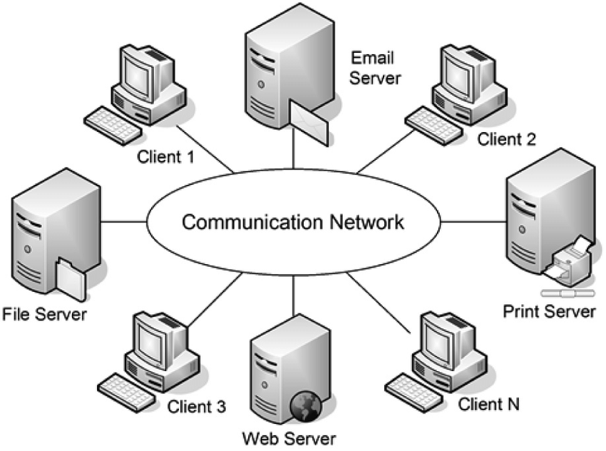
Fig.1 Distributed System

Slide 6
Features Of Distributed System
Concurrency
Reliability
Scalability
Economy
Transparency
Fault tolerance
Load balancing

Slide 7
Concurrency
The components or the independent computers of the distributed system enhances the concurrent execution in the network environment.
These components access shared resources at the same time, leads to the concurrency hence it optimizes the performance of the network.

Slide 8
Reliability
One of the main feature of DS is a high-level reliability. Reliability is most often considered from the perspectives of availability and security of a system’s hardware, services and data.
If one machine crashes, the system as a whole can still survive. Thus Higher availability and improved reliability.

Slide 9
Scalability
When the number of users are increasing, the system should work efficiently. And addition of a resource such as a processors, memory and hard disk should enhance the performance of the system.

Slide 10
Economy
Sharing of resources by many entities will help to reduce the cost of ownership.
A collection of microprocessors offer a better price/ performance than mainframes computers.
way to increase computing power.

Slide 11
Transparency
The entire system should appear as a single unit and the complexity and interactions between the components should be typically hidden from the end user.

Slide 12
Fault tolerance
Computers connected in DS may fail independently such that failure of one or more components should not bring down the entire system and should be isolated.
The failed processor in any way doesn’t effects the working efficiency of the other processor.

Slide 13
Load balancing
Allow the movement of tasks within a system without affecting the operation of users or the applications.
Distribute the load among available resources for improving the performance and the speed of excecution.

Slide 14
Nodes of a Distributed System
In a communication networks, a node is a connection point, either a communication endpoint( some terminal equipment).It is an electronic device that is capable of sending, receiving or forwarding information over a communication channel. In a DS, the nodes are clients, servers or peers...

Slide 15
Clients and Servers
When we talk about the word client, it mean to talk of a person or an organization using a particular service. Similarly in the digital world a Client is a computer(Host) i.e. capable of receiving information or using a particular service from the service providers(Servers).
Similarly, when we talk the word Servers, It mean a person or medium that serves something. Similarly in this digital world a Server is a remote computer which provides information(data) or access to particular services.

Slide 16
Existing large client applications are being switched to websites, making the browser a sort of a universal client. This avoids the hassle of downloading a large piece of software onto any computer you want to use the application on. An example : world wide web
Server is a physical computer dedicated to running one or more such services, to serve the needs of users of the other computers on the network. Depending on the service that it offers it could be a database server, file server, mail server, print server, web server etc.

Slide 17
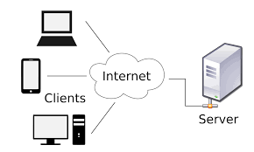
Fig. 2 Client – server Based service model

Slide 18
Peer to peer(P2P) networks
P2P computing or networking is a distributed application architecture that partitions tasks or workload among peers.
Peers can share their resources such as disk storage, processing power directly to the other peers( system‘s) without the need of any central server coordination.
Peers are both suppliers and consumers of resources, in contrast to the traditional client-server model where only servers supply and clients consume.
A peer may sometimes serve as a client, sometimes as a server.

Slide 19
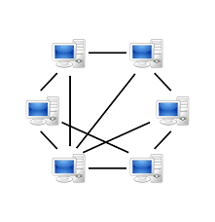
Fig. 3 P2P networks

Slide 20
Distributed Computing and its Paradigms
Paradigms for distributed computing can be of two types:
Interprocess communication- In this type of application participation of at least two independent entities and the processes must have the ability to exchange data among themselves.
Event synchronization- Sending and receiving of the data must be synchronized in a distributed application.

Slide 21
The basic patterns and models of distributed applications are given below:
The Message Passing Paradigm
The client- Server Paradigm
The Peer to Peer Architecture
Message System Paradigm
Remote Procedure Call
The Distributed Objects Paradigms
Remote Method Invocation(RMI)
The Network Services Paradigm
The Object Request broker Paradigm
The Mobile Agent Paradigm
The collaborative Application Paradigm

Slide 22
The Message Passing Paradigm
This the most fundamental paradigm of distributed applications.
A process send a msg representing a request.
The msg is delivered to the receiver, which processes the request and sends a msg in response.
In turn, the reply may trigger a further req,which leads to a subsequent reply and so forth.

Slide 23
The Client-Server Paradigm
The server, plays the role of a service provider which waits passively for the arrival of requests. The client, issues specific requests to the server and awaits its response.
By assigning asymmetric roles to the two sides, event synchronization is simplified: the server process waits for the requests and the client in turn waits for responses.
The Peer to Peer System Architecture: p2p is an architecture where computer resources and services are directly exchanged between computer systems.
These resources and services include the exchange of information, processing cycles, cache storage and disk storage for files.

Slide 24
The Message System Paradigm
In this type of paradigm , a message system will serves as a intermediate node among separate, independent processes.
A sender deposits a message with the message system, which forwards it to a message queue associated with each reciever.Once a message is sent, the sender is free to move on to other tasks.
The message system paradigm is an elaboration of the basic message-passing paradigm.

Slide 25
Remote Procedure Call
RPC implement the inter process communications through procedures or function calls, which are similar to application programming.
A remote procedure calls involves two independent processes, which may resides on separate machines. A process A, wishing to make a request to another process B, issues a procedure call to B, passing with the call a list of argument values. A remote procedure call triggers a predefined action in a procedure provided by process B. At the completion of the procedure, process B returns a value to process A.

Slide 26
Remote Method Invocation(RMI)
In this model, a process invokes the methods in an object, which may reside in a remote host.
As with RPC, arguments may be passed with the invocation.
Network Services Paradigm
In this paradigm, service providers register themselves with directory servers on a network.
A process desiring a particular service contacts the directory server at run time, and, if the service is available, will provide a reference to the service.
Using the reference, the process interacts with the service.

Slide 27
Distributed Objects Paradigms
The idea of applying object orientation to distributed applications is a natural extension of object oriented software development.
Applications access objects distributed over a network.

Slide 28
Object Request broker Paradigm
In the Object broker Paradigm, an application issues requests to an object request broker (ORB), which directs the request to an appropriate object that provides the desired service.
This is quite similar to the RMI model in its support for remote object access.The difference is that the object request broker in this paradigm functions as a middleware which allows an application, as an object requestor, to potentially access multiple remote( or local) objects.

Slide 29
The Mobile Agent Paradigm
The mobile agent is a transportable program or object.
In this model, an agent is launched from an originating host.
The agent travels from host to host, at each stop, the agent accesses the necessary resources or services, and performs the necessary tasks to accomplish its mission.

Slide 30
The Collaborative Application Paradigm
In this model ,processes participate in a collaborative session as a group. Each participating process may contribute input to all of the group.
Processes may do so using:
multicasting to send data to all or part of the group or they may use a virtual whiteboard which allows each participant to read and write data to a shared display.

Slide 31
Models of Distributed System
There are three Models used in a Distributed System-
Architectural Models
Interaction Models
Failure Model

Slide 32
1.Architectural Models
An architectural model defines the way in which the components of system interact with one another and the way in which they are mapped onto an underlying network of computers.
The placement of the components across a network of computers.
The interrelationship between the components.

Slide 33
The architectural model described number of various models which are describe below:
Client-Server model
Peer to Peer Model
Proxy server
Mobile code
Mobile Agent
Network Computers
Mobile devices

Slide 34
Proxy server
Proxy server is a server that acts as an intermediary for requests from clients seeking resources from other servers. A client connects to the proxy server, requesting some services such as a file, connection ,web page or other resource available from a different server.
The proxy server evaluates the request according to its filtering rules. For example, it may filter traffic by IP address or protocol. If the request is validated by the server , the proxy server provides the resource by connecting to the relevant server.

Slide 35
Mobile Code
Mobile code is a software transferred between systems, e.g. transferred across a network via a USB flash drive and executed on a local system without explicit installation or execution by the recipient.
Mobile code also refers to code “used for rent”, a way of making software packages more affordable i.e. to use on demand.

Slide 36
Mobile Agents
A mobile agent is a composition of a computer software and data which is able to migrate from one computer to another computer autonomously and continue its execution on the destination computer.
Just as a user directs an Internet browser to “visit” a website, then the browser downloads a copy of the site or one version of it in the case of dynamic web sites, similarly, a mobile agent decides to move, it saves its own state, transports this saved state to the new host and resumes execution from the saved state.

Slide 37
Network Computers
Network computers is a trademark of Oracle Corporation that was used, from 1996 to 2000,to market a range of disk less desktop computer devices
NC do not store locally operating system or application code, code is loaded from the servers and run locally on the network computer.

Slide 38
Mobile Devices
A mobile device is a small, hand held computing device,typicallly having a display screen with touch input and a miniature keyboard and less than 2 pounds.
As an increasing number of devices now are focusing on data storage and display, but also on communication and processing.

Slide 39
2.Interaction Models
Interaction deals with the performance and with difficulty of setting time limits in a distributed system.
In a DS it is hard to set time limits on the time taken for process execution, message delivery or clock drift.
Two opposite extreme positions provide a pair of simple models:
Synchronous DS: it has a strong assumption of time
Asynchronous DS: it makes no assumption about time.

Slide 40
3. Failure Models
Failure model attempts to give a precise specification of the faults that can be exhibited by processes and communication channels.
Four possible classifications of the failures are : omission failure, value fault/failure, timing fault/failure, arbitrary fault/failure

Slide 41
Omission failure- a component that does not respond to an input from another component, and thereby fails by not producing the extended output is exhibiting an omission fault.
Value fault- a fault that causes a component to respond within the correct time interval but with an incorrect value is termed a value fault.
Timing fault- a timing fault causes the component to respond with the correct value but outside the specified interval. The corresponding failure is the timing failure.

Slide 42
Arbitary fault/failure:the previous failure classes have specified how a component can be considered to fail in either the value or time domain.it is possible for a component to fail in both the domains in a manner which is not covered by one of the previous classes.
A failed component which produces such an output said to be exhibiting an arbitrary failure.

Slide 43
TYPES OF OPERATING SYSTEM
Operating system: an Operating system is a set of programs that manage computer hardware resources and provide common services for application software.

Slide 44
1. Centralized OS

